Slide 1

SIR C R REDDY COLLEGE OF ENGINEERING DEPARTMENT OF COMPUTER SCIENCE AND ENGINEERING
ACCIDENT DETECTION FROM CCTV FOOTAGE
IV B . Tech II Sem Project power point presentation
By
CH. CHINA SIVA SATYAM (20B81A0533)
C. LASYAPRIYA(20B81A0534)
CH. BHARGAV KALYAN(20B81A0535)
CH. VENKATA KAVYA(20B81A0536)
D.BHARGAVI(20B81A0537)
Under the guidance of G . SRI DIVYA

Slide 2
Abstract
Traffic has become an integral part of people's life in recent years, influencing a wide range of human activities and services. Accidents have been a leading cause of death worldwide, particularly in India. Approximately more than 80% of accident related deaths cases are caused by lack of timely assistance to accident victims rather than the accident itself. One of the basic reason for the vehicle accident is the vehicle speed and there are many others too. Many lives can be saved if there was a proper emergency service that could get accident information in time. Computer vision-based accident detection on traffic video surveillance is an advantage.

Slide 3
Literature survey
Brown, M., & Jones, A. “Abnormal vehicle crash detection using convolutional neural networks."
Y. Ki and D. Lee, "A traffic accident recording and reporting model at intersections", IEEE Transactions on Intelligent Transportation Systems, vol. 8, no. 2, pp. 188-194, June 2007.
E. P. Ijjina, D. Chand, S. Gupta and K. Goutham, "Computer Vision-based Accident Detection in Traffic Surveillance," 2019 10th International Conference on Computing, Communication and Networking Technologies (ICCCNT), Kanpur, India

Slide 4
Problems in Existing System
1.Delayed Detection:
Manual observation means that accidents are detected only after they have occurred. This can result in significant delays in alerting emergency services, leading to potentially worse outcomes for accident victims.
2.Limited Coverage:
The system's effectiveness is limited to situations where there are passengers or witnesses present to observe and report accidents. It may not work in isolated or less-traveled areas where there are no witnesses.
3.Inefficient Resource Allocation:
Without accurate and timely accident detection, resources like emergency responders, police, and medical services may not be efficiently allocated to the right locations.
4.Privacy and Ethical Concerns:
Passengers observing accidents may inadvertently capture private and sensitive information, which can raise privacy and ethical concerns.
5.Lack of Data for Analysis:
Manual observation does not provide a systematic and consistent data source for analyzing accident patterns and improving road safety.

Slide 5
Proposed System:
Implement a robust object detection model to identify vehicles, pedestrians, and other relevant objects in the CCTV footage.
Train a classifier to differentiate between normal and accident scenes based on visual cues. Use a labeled dataset to teach the system what constitutes an accident.
Implement a system for continuous monitoring and maintenance to address any performance degradation or system drift over time.
You can implement your system in a cost-effective manner considering infrastructure, model development, training and maintenance .
Utilize motion analysis techniques to identify sudden and abnormal movements in the video frames, which might indicate a potential accident.

Slide 6
Problem Statement
Develop a Convolutional Neural Network (CNN) model for real-time vehicle crash detection.
Implement an efficient image processing pipeline to preprocess and augment crash-related datasets for CNN training.
Investigate and optimize CNN architecture parameters to enhance the model's accuracy in identifying different types of vehicle crashes.
Investigate methods for continuous learning and adaptation of the CNN model to evolving patterns in vehicle crash scenarios.
Consider ethical implications and privacy concerns associated with deploying a vehicle crash detection system based on CNN technology.

Slide 7
Modules
1.Data Loading and Preprocessing Module
2.Model Building Module
3.Training Module
4.Visualization Module
5.Prediction Module

Slide 8
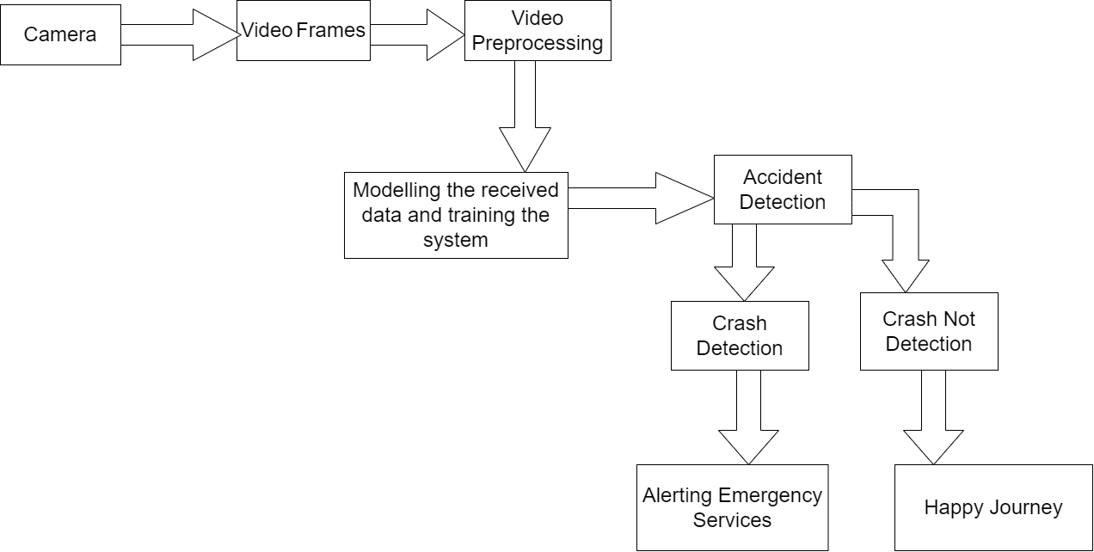
System Architecture

Slide 9
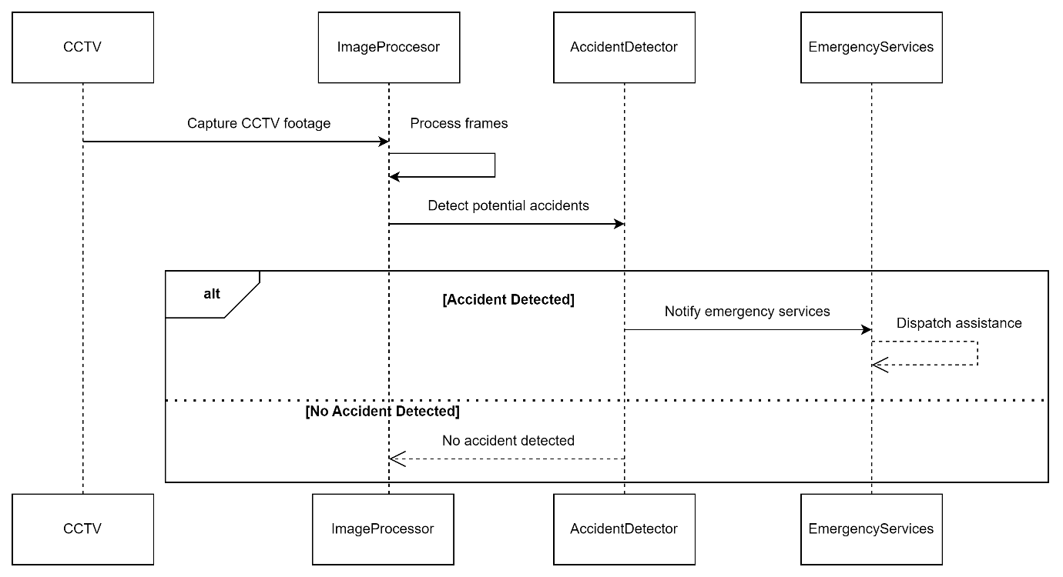
Sequence Diagram

Slide 10
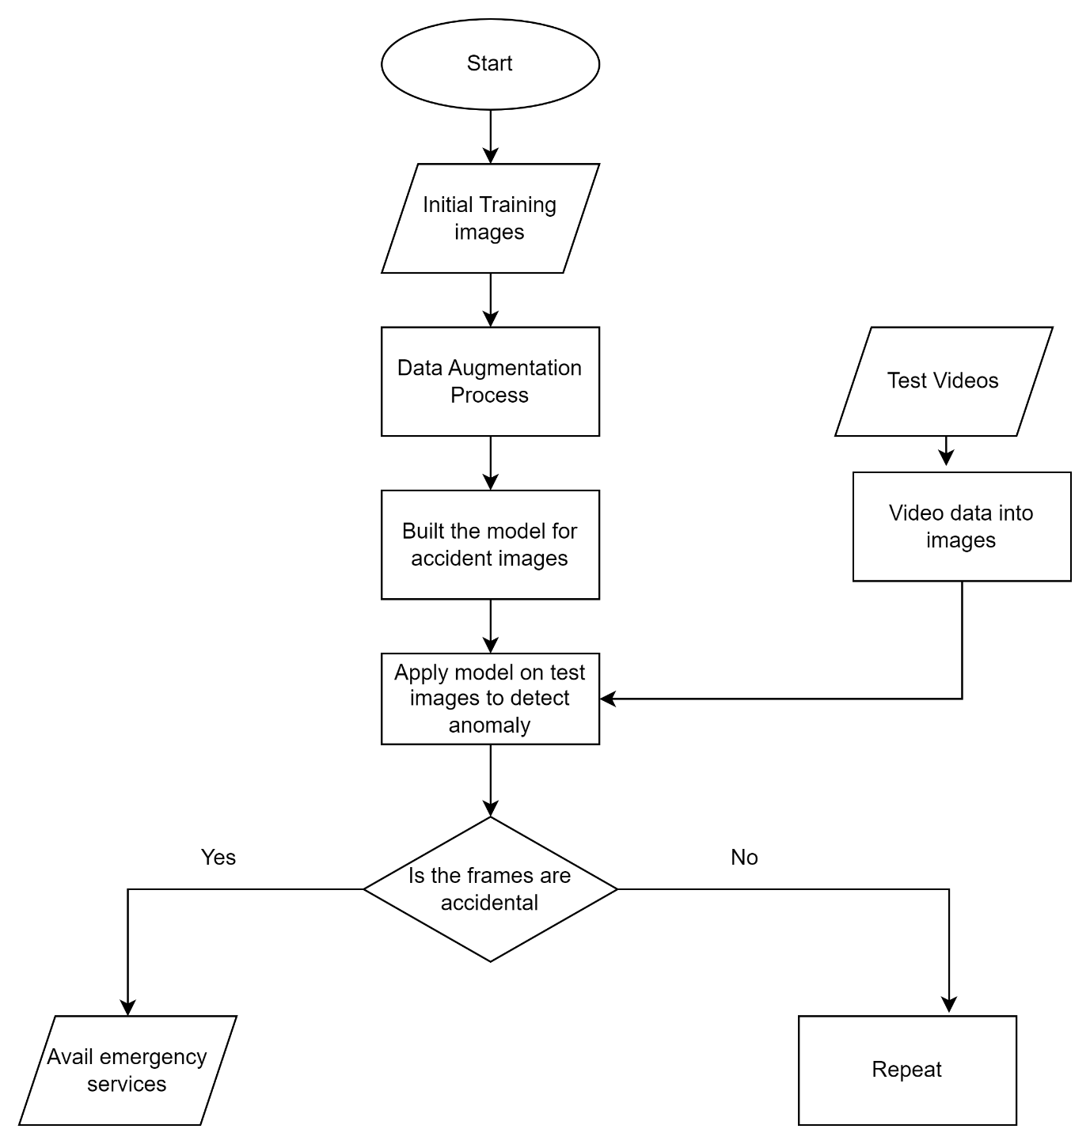
ControlFlow Diagram

Slide 11
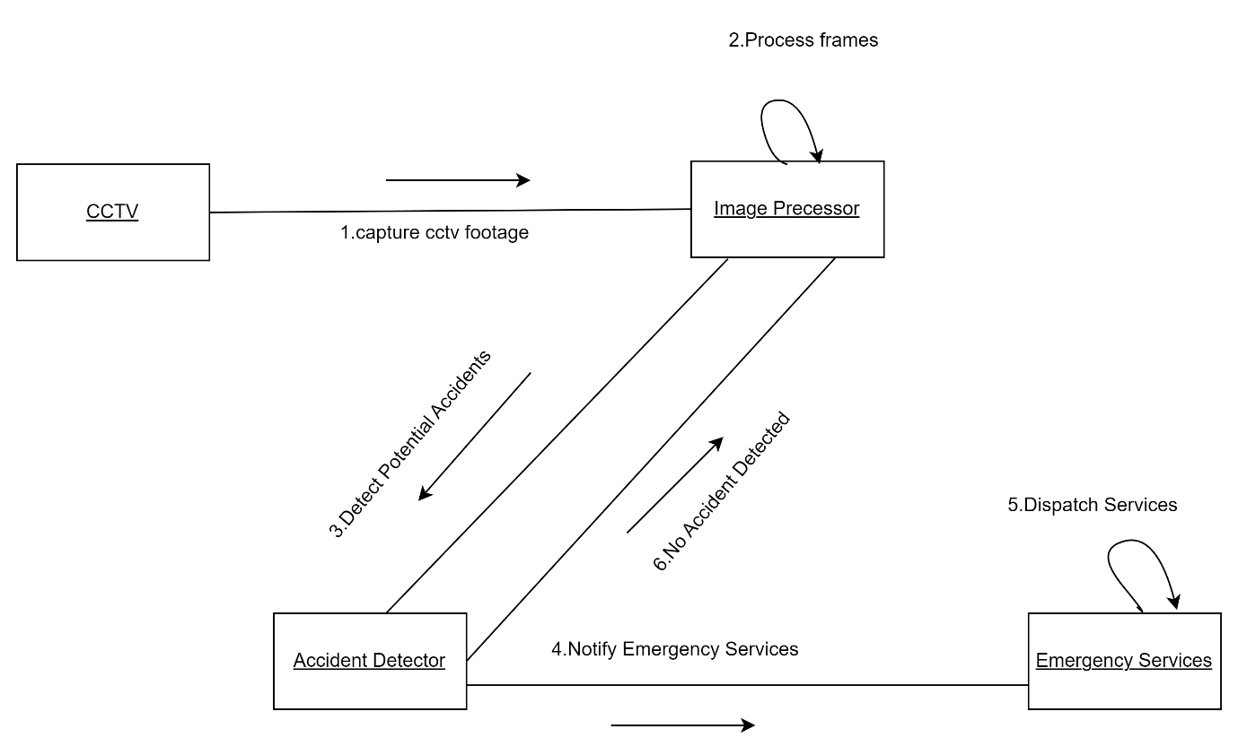
Collaboration diagram

Slide 12
Algorithms
Convolutional Neural Networks :
Convolutional Neural Networks (CNNs) are a type of deep learning neural network that excel at tasks involving visual imagery.
They are specifically designed to analyze and recognize patterns in image data, making them highly valuable in computer vision applications.
CNNs achieve this through a series of specialized layers that progressively extract increasingly complex features from the input image.
The convolutional layers are the key component of a CNN.
The output of the convolutional layers is then passed through pooling layers, which are used to down-sample the feature maps, reducing the spatial dimensions while retaining the most important information.
The output of the pooling layers is then passed through one or more fully connected layers, which are used to make a prediction or classify the image.

Slide 13
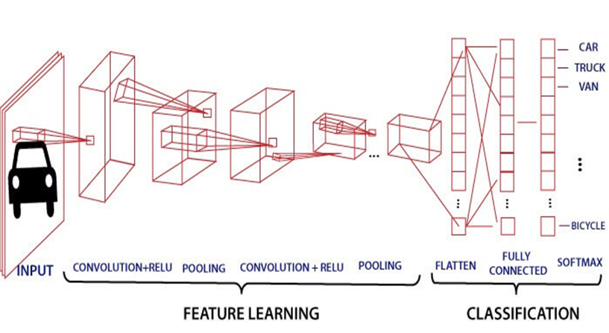

Slide 14
MobileNetv2:
MobileNetv2 is a promising choice for an accident detection system using CCTV footage due to its efficient architecture.
Efficiency: MobileNetv2 is a lightweight model designed for mobile and embedded devices. This makes it ideal for real-time processing of CCTV footage, which can be computationally demanding .
Accuracy: Despite its efficiency, MobileNetv2 offers good accuracy for image classification tasks. This is crucial for an accident detection system, as it needs to reliably distinguish between normal and accident scenarios.
Transfer Learning: Pre-trained MobileNetv2 models are readily available, allowing you to leverage pre-learned features for accident detection. This can significantly reduce training time and effort compared to training a model from scratch.

Slide 15
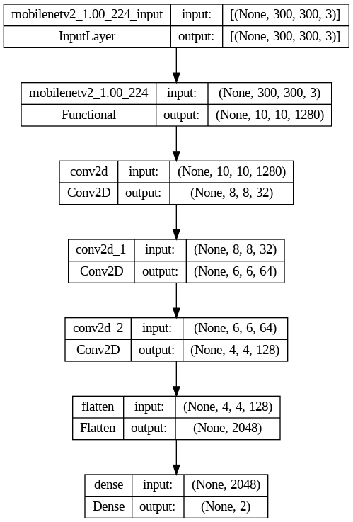
Implementation :
MODEL PLOT :

Slide 16

Training Performance Graph and Validation Performance Graph

Slide 17
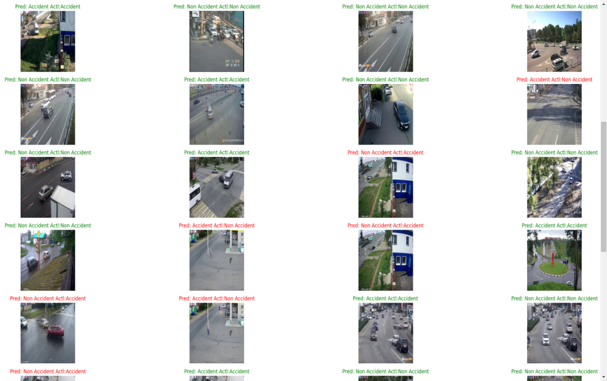
Output-1

Slide 18
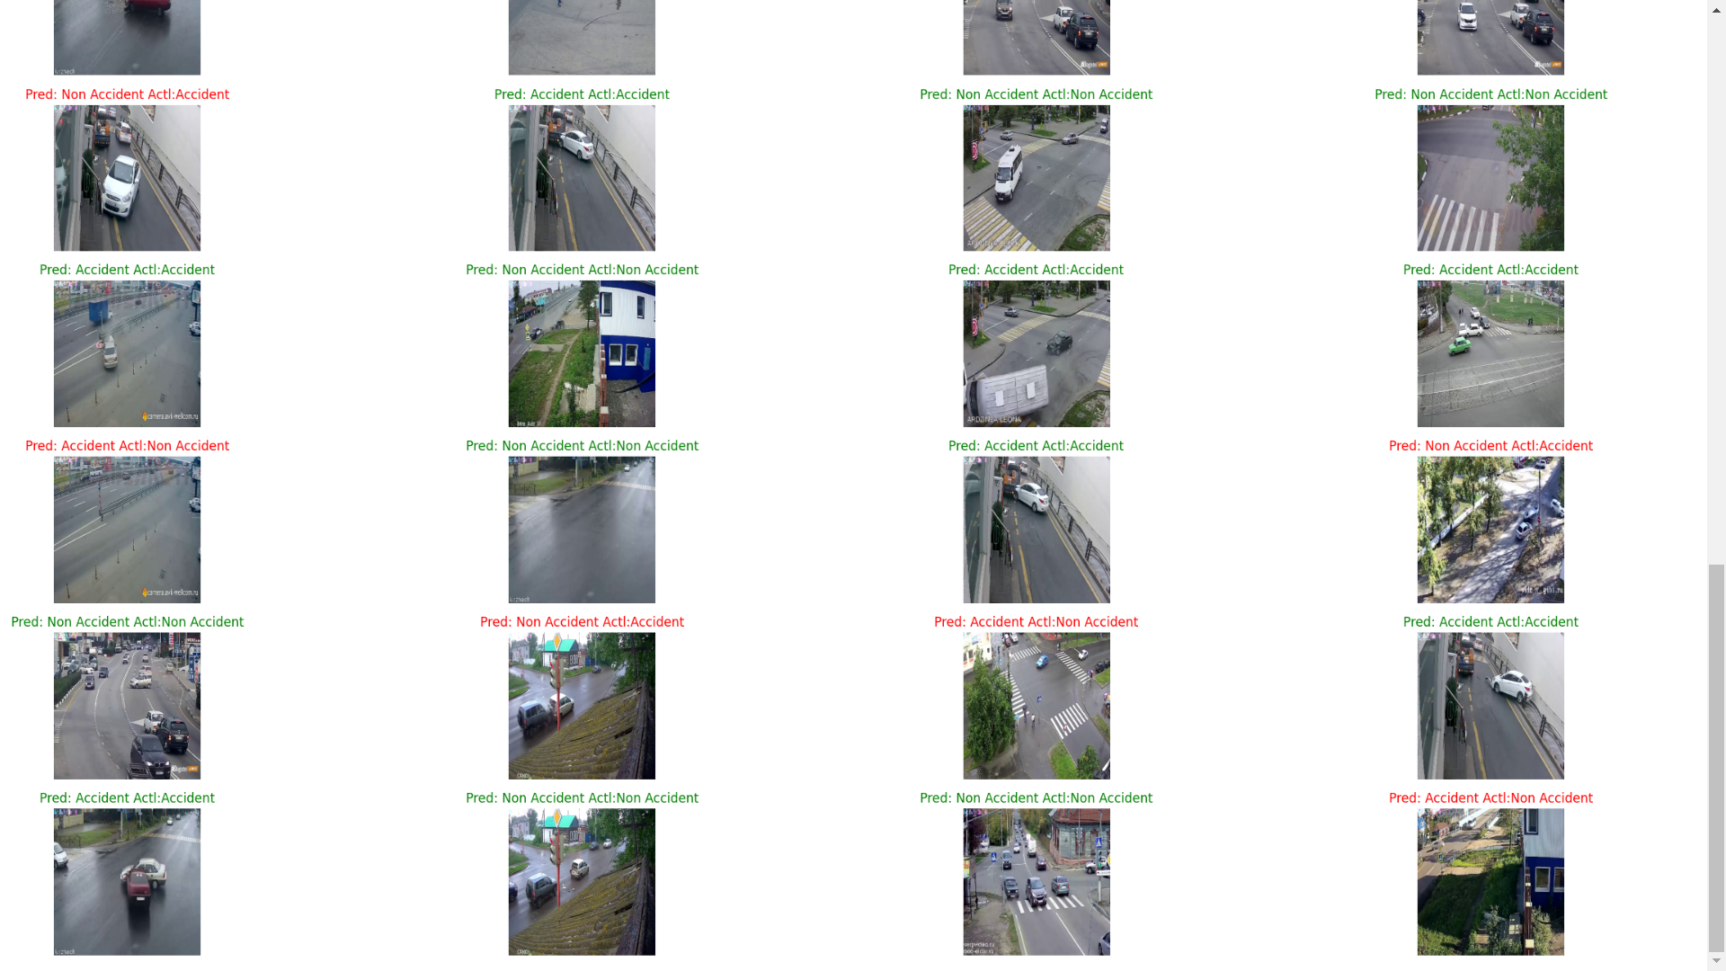
Output-2

Slide 19
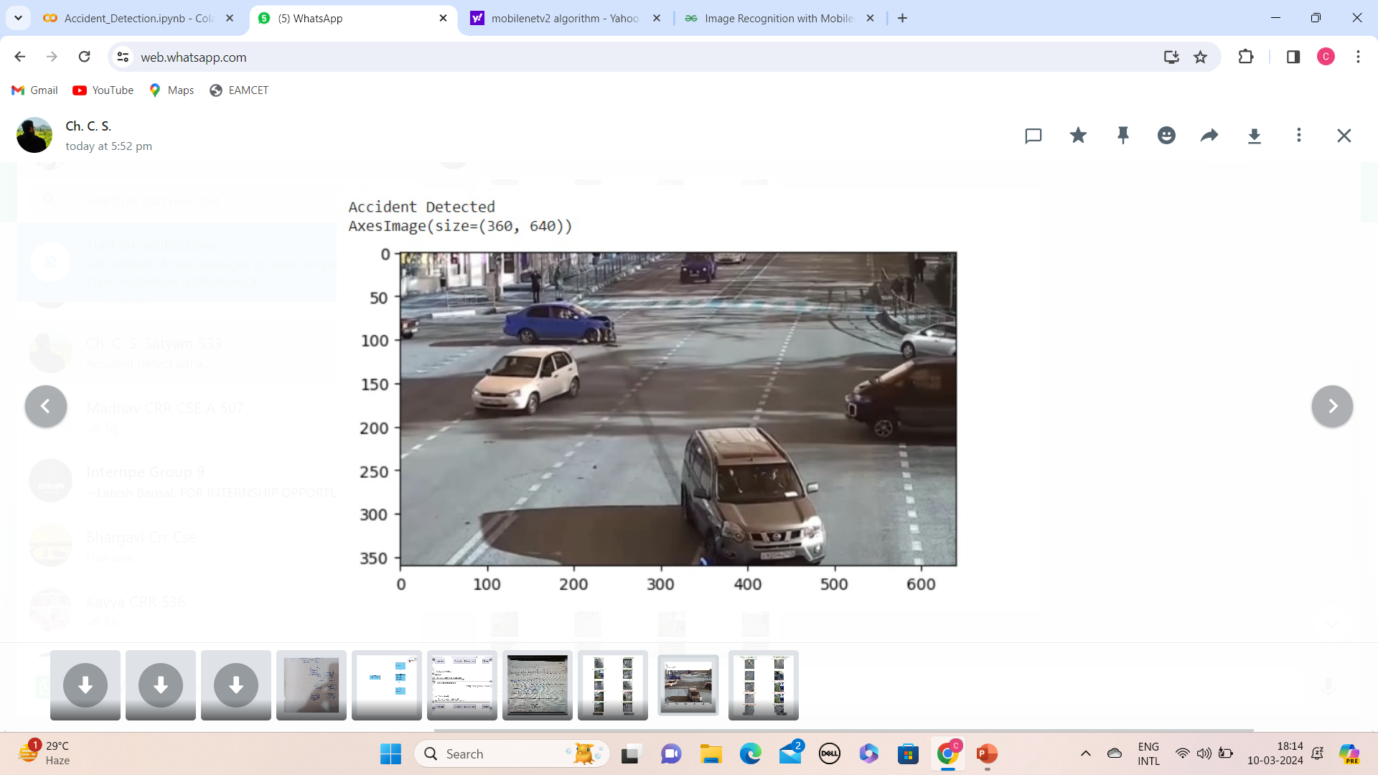
Input :
Video will be given as input and detect accidents in the video frames
Video frame :

Slide 20
Output :

Slide 21
Conclusion
Employing deep learning models for accident detection from CCTV footage offers a promising solution to enhance public safety suitable for deployment across various traffic surveillance networks, contributing to improved overall traffic management and road safety. and streamline emergency response systems. By leveraging neural networks, these systems can autonomously analyze video streams, promptly identifying and classifying accidents or unusual events. This technology enables quicker incident detection, facilitating rapid response times and potentially mitigating the severity of accidents. Furthermore, the scalability and adaptability of deep learning models make them suitable for deployment across various traffic surveillance networks, contributing to improved overall traffic management and road safety.

Slide 22
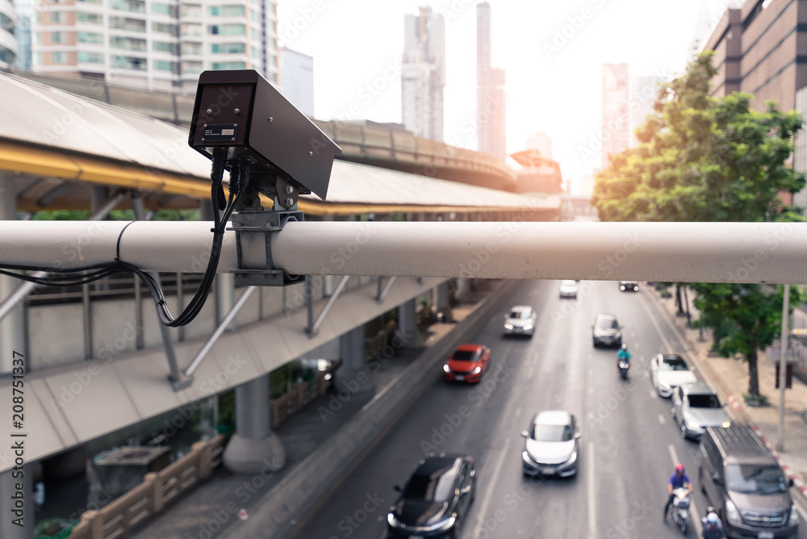
THANK YOU
CH. CHINA SIVA SATYAM (20B81A0533)
C. LASYAPRIYA(20B81A0534)
CH. BHARGAV KALYAN(20B81A0535)
CH. VENKATA KAVYA(20B81A0536)
D.BHARGAVI(20B81A0537)
Under the esteemed guidance of
G. Sri Divya

